Slide 1
Tom Bragg Project 2 To do list

Slide 2
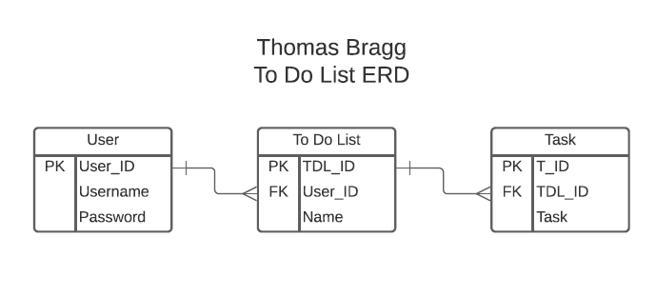
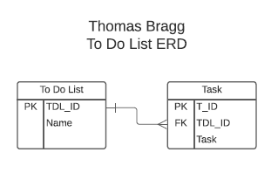
Sprint 1 - Backend
Initial research into the project
Sprint 2 – Testing + Frontend

Slide 3
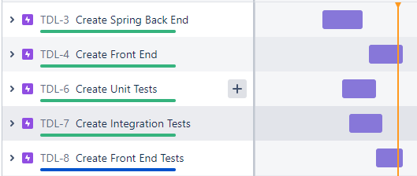
Anticipated timeline
Note – MoSCoW method used to prioritise

Slide 4
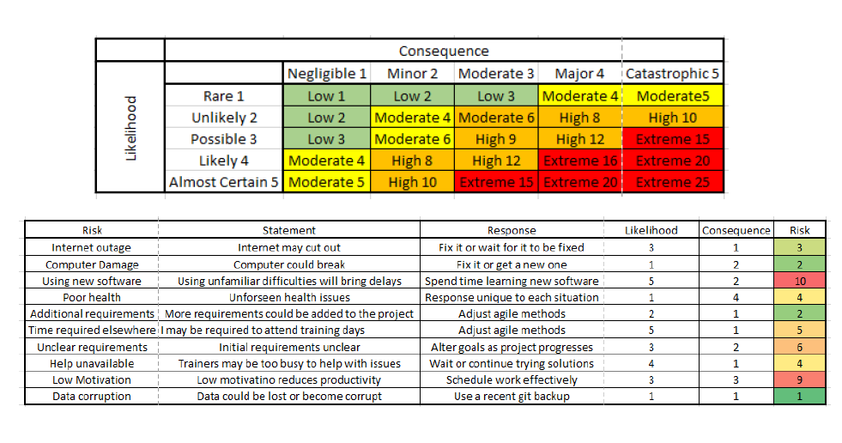
Risk Assessment

Slide 5
Technologies used
MySQL
Java
Spring Boot
JUnit + Mockito
(Selenium)
HTML
JavaScript
CSS
SonarQube
Jira
Git
GitHub
Maven

Slide 6
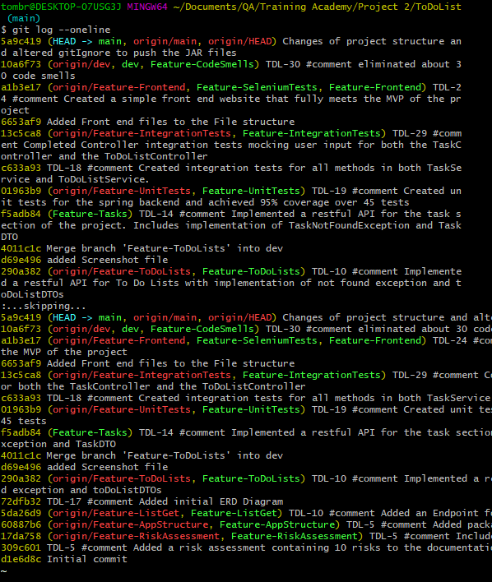
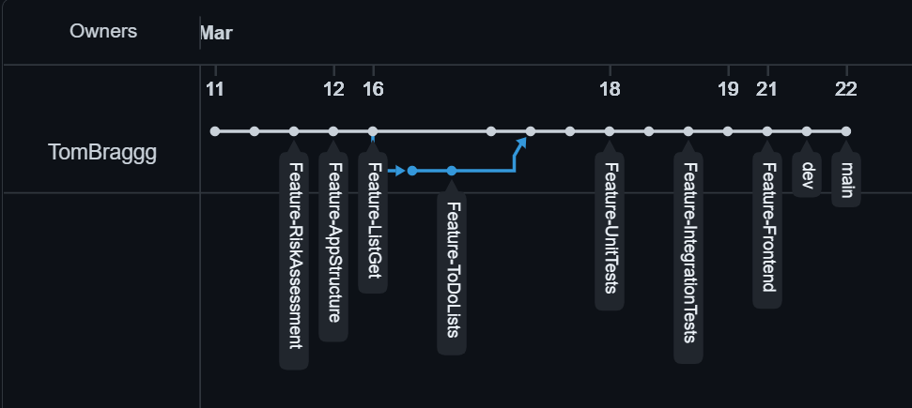
Git process and Version control
Feature branch model

Slide 7
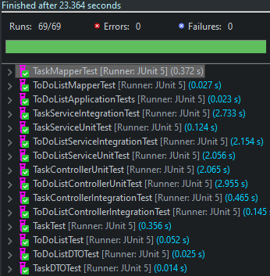
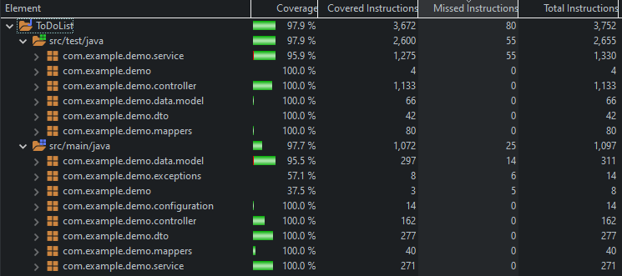
Testing

Slide 8
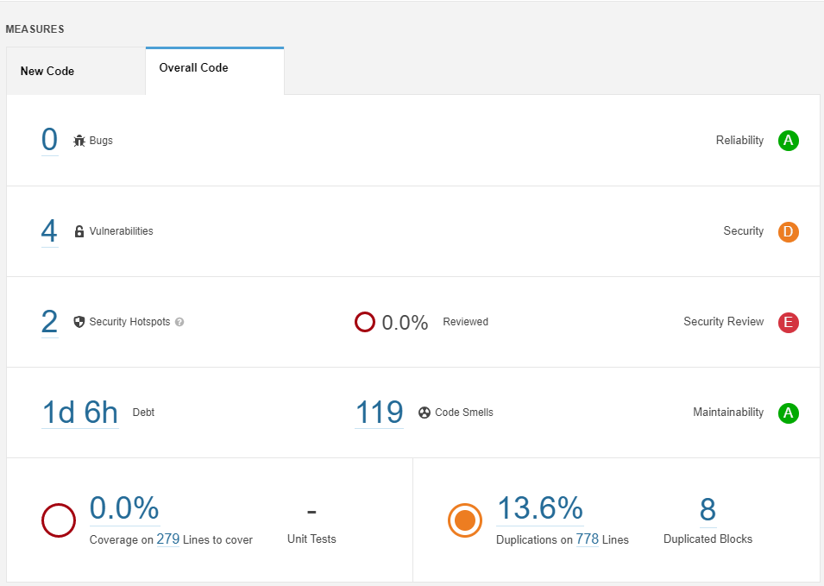
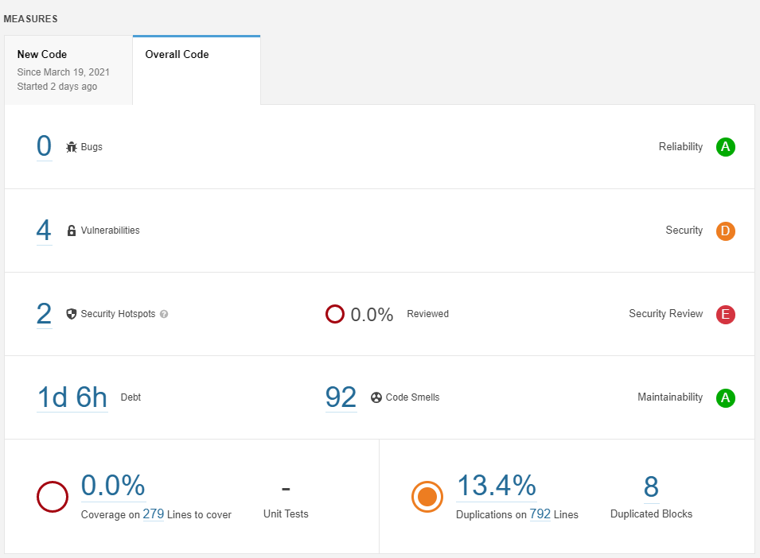
Code Smells

Slide 9
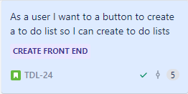
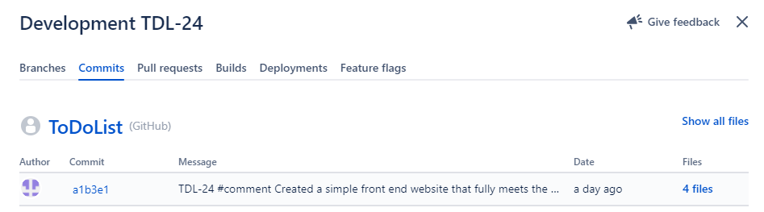
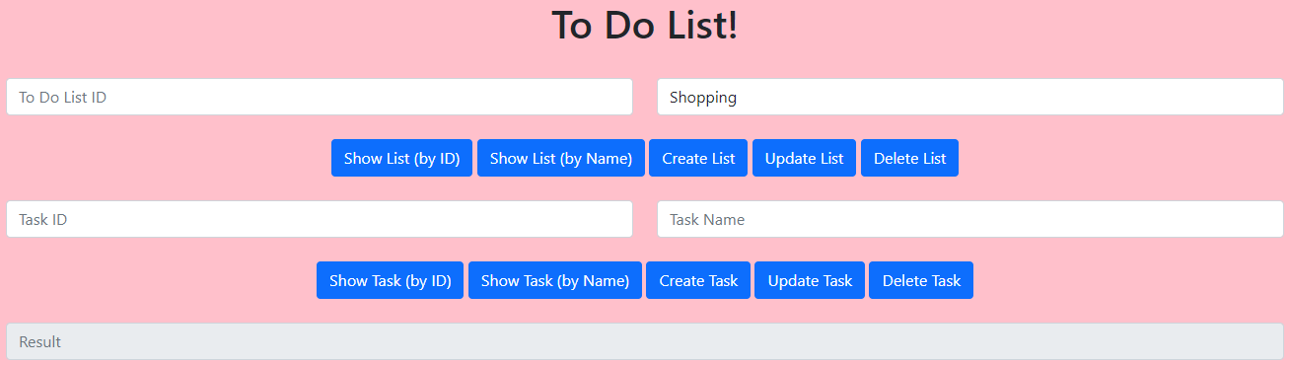
A few user stories

Slide 10
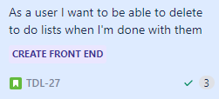
A few user stories
Note - these user stories were handled with the same commit

Slide 11
Sprint Reviews
Fully happy with the backend of the project including tests
Front end is lacking due to time constraints and burnout
Selenium tests were being written but documentation of the project took priority
Swagger is left untouched

Slide 12
Sprint Retros
General workflow was good – Stuck to a working day structure
Story points are very arbitrary – Spikes?
Prioritisation of testing appropriate for the project but left front end a little neglected
Git and version control management ran well

Slide 13
Final thoughts
Started off frustrated but found the whole project very rewarding
Learnt lots of different technologies – looking at slide 3 feels surreal for 8 weeks of progress
Given more time
Selenium testing complete
Make the front end more intuitive
Add users as per my initial ERD

